Slide 1
V.A.S.T
Velocity of Air and Surface Temperature
Crusading Towards a more Renewable Future
Notes:
Eric

Slide 2




Meet The Cyber Crusaders!
Jordan
Oberstein
Eric
Carson
Dani
DiTomasso
Yousif Moftah
Daniel Dorticos-Rossi
Notes:
Everyone

Slide 3
Project Summary
Display Surface Temperature and Wind Speed in the state of New York in an easy to understand fashion.
The user can draw their own conclusions as to where the best location to place renewable energy sources would be.
Notes:
Daniel

Slide 4
Users
Educator
Formal K-16 educator, or with an informal organization.
Has limited experience using NASA Earth Science data, but would like to download and utilize data for their environment.
Notes:
Eric

Slide 5
Stakeholders
Students
Most likely will access data through the educators instruction.
Expectation of capability to download data visualizations or download data in specific file formats; can link different types of data or even overlay data sets.
Notes:
Eric

Slide 6
Stakeholders
Data interested civilians
Our website still serves as an easily accessible hub for useful organized data.
Notes:
Eric

Slide 7
Stakeholders
NASA
Access to a more concise set of data for New York surface temperature and wind velocity
Can be used for educator or informational programs
Notes:
Eric
Maybe: increased traffic on nasa data websites

Slide 8
Stakeholders
Data Analysts
Experienced Data Analysts can analyze results of data to advise inexperienced users on energy decision making.
Can similarly be used by engineers to determine scale of energy systems when designing power plants.
Notes:
Eric

Slide 9






Technologies
HTML
CSS
Node/Express
MongoDB
Javascript
Bootstrap
Notes:
Yousif

Slide 10
Project Timeline
FEB
MAR
APR
APR
24
31
14
25
API / Javascript
INtegration
FInal Project
HTML/CSS/
Bootstrap
API will be built and functional
API and JavaScript will be combined with HTML / CSS
Application and Final Presentation completed.
Layout will be nearly complete.
Notes:
Yousif

Slide 11
Functional vs Nonfunctional Requirements
Category | Objective | Visualization
Functional | Display Surface Temperature and Wind Speed in the state of New York | Data Displays New York data over specific time period
Nonfunctional | Pull data from NASA website for filtration and organization | Use API to organize filtered data to allow easy access of provided data
Notes:
Jordan

Slide 12
Functional vs Nonfunctional Requirements
Category | Analysis | Testing
Functional | Users can interpret conclusions from data displayed | Feedback from users with and without data experience including instructors
Nonfunctional | Data will be presented as a listing of data from the API without conclusive analysis | Vulnerability testing (Zap) Consistent API organization
Notes:
Jordan

Slide 13
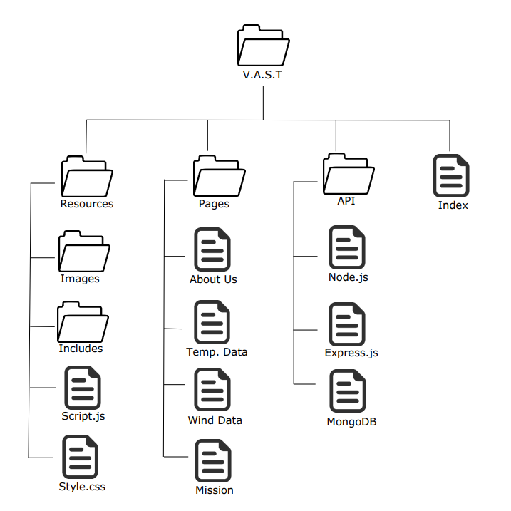
Sitemap
Notes:
Dani

Slide 14
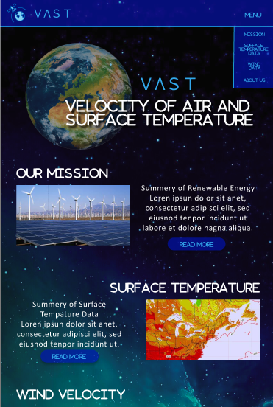
WIreframe (Home Page)
Notes:
Dani

Slide 15
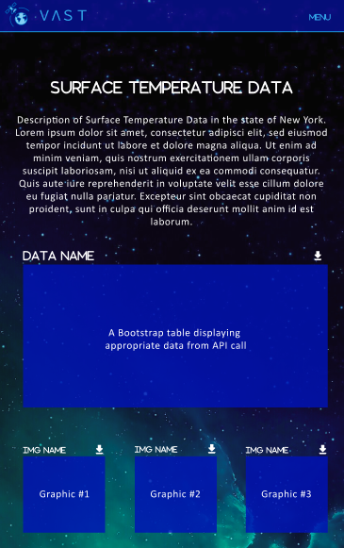
WireFrame
(Data Page)
Notes:
Dani

Slide 16
Thank you!
Any Questions?
Notes:
Dani

